Slide 1


CONTINUOUS
ARCHITECTURE
IS
AN OPEN SOURCE INITIATIVE
For Digital and Agile enterprises wanting to leverage the architecture discipline to better steer their transformation journey while coping with the exponential flow of changes. Continuous Architecture Toolkit provides materials (posters, kits, roles description, rituals) to frame the new way of doing architecture and accelerate the change among architects, delivery and operation teams.

Slide 2


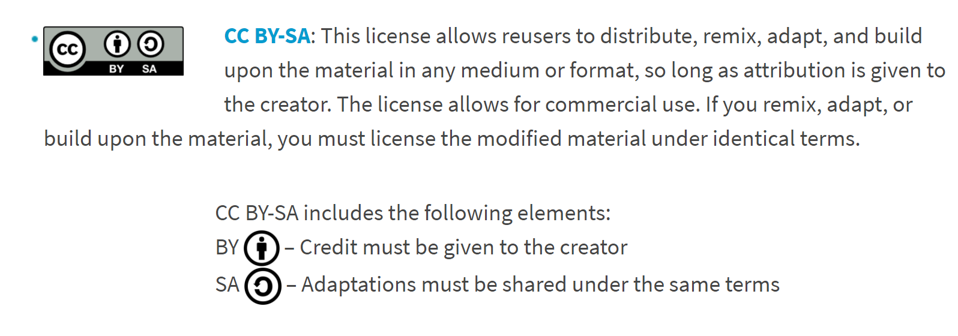
Apache License, Version 2.0
Continuous architecture materials are distributed under Apache License 2.0 apart from illustrations which are distributed under Creative Common Attribution ShareAlike 4.0 International License.

Slide 3



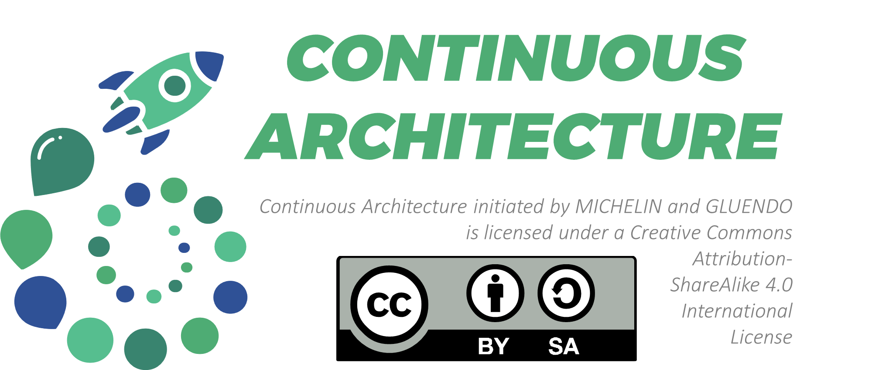
TEAM MEMBER….
ENTERPRISE ARCHITECT
FULL STACK ARCHITECT
PRODUCT
ARCHITECT
BUSINESS
ARCHITECT
Continuous Architecture Toolkit deals with architecture practice as a whole and can be useful for all persons involved in architecture activities whatever its role.

Slide 4
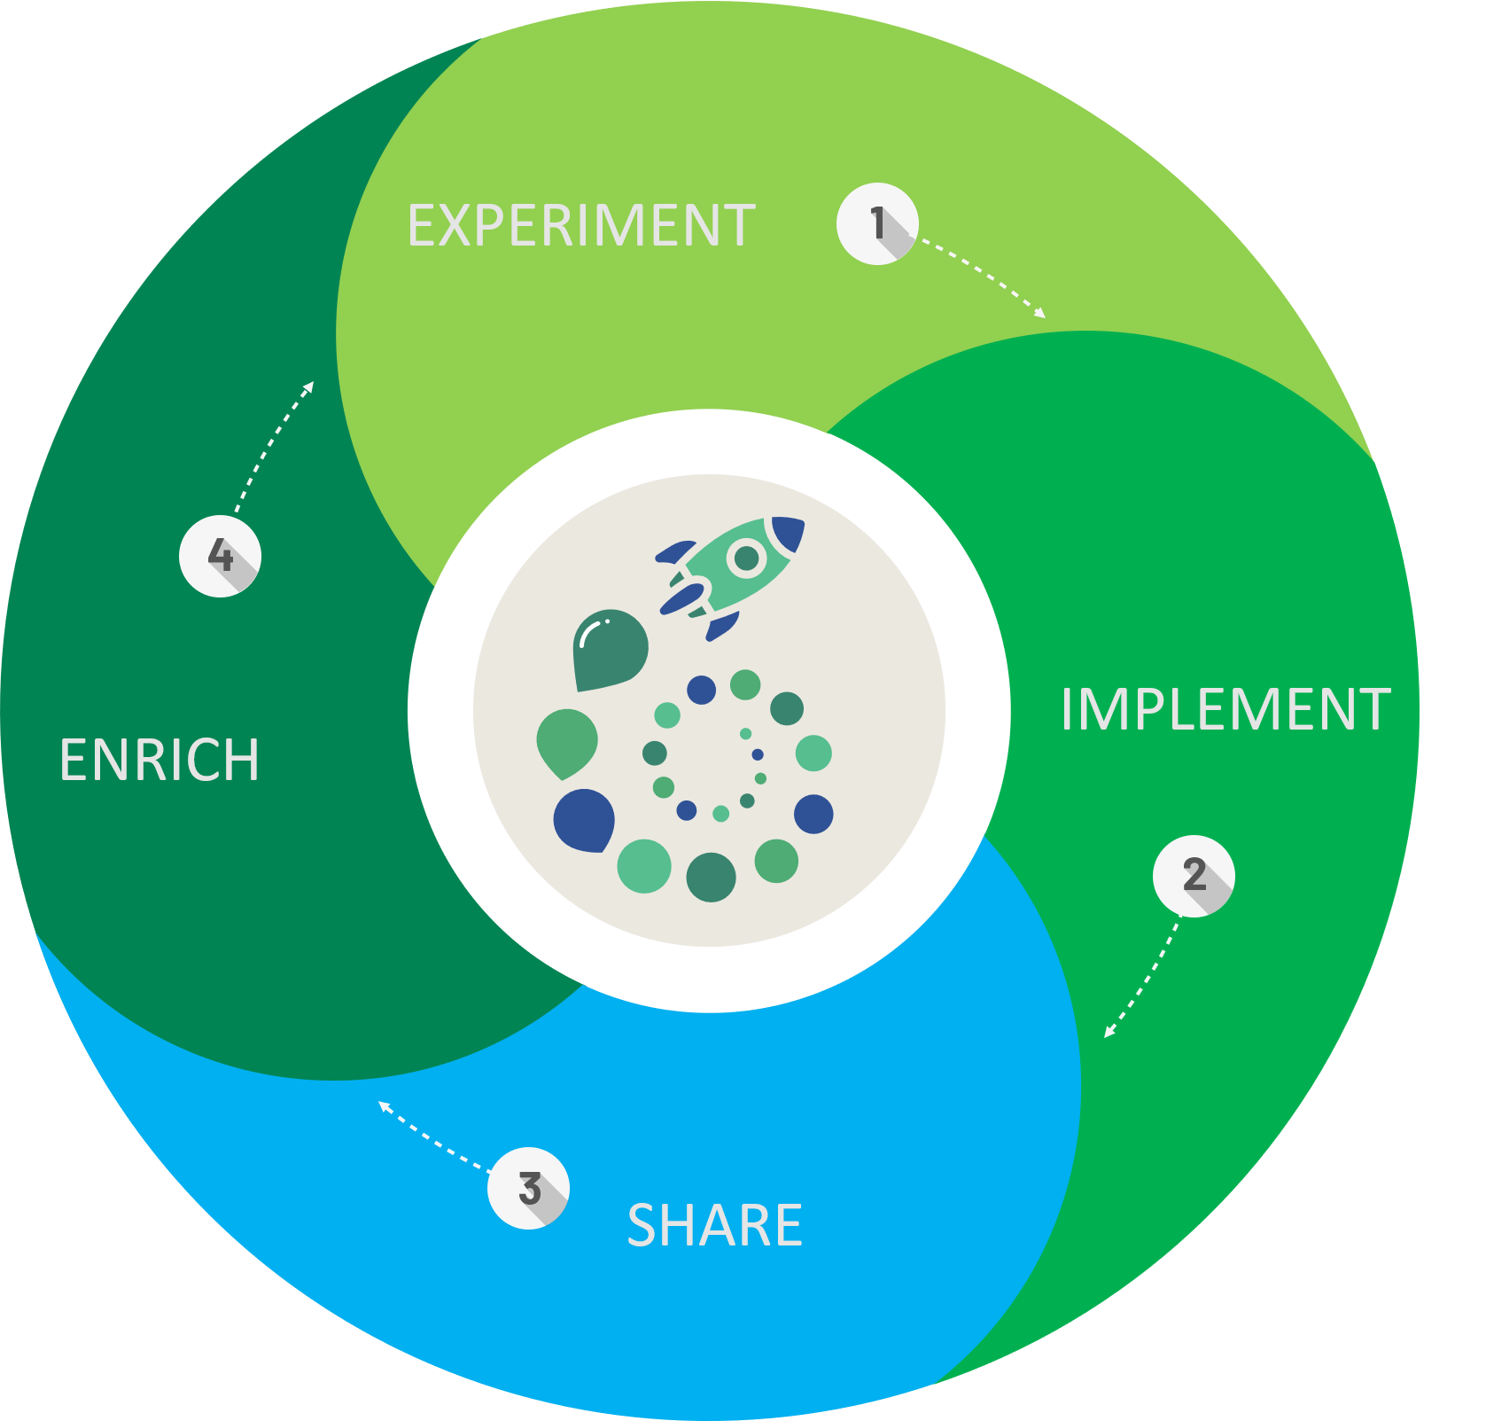

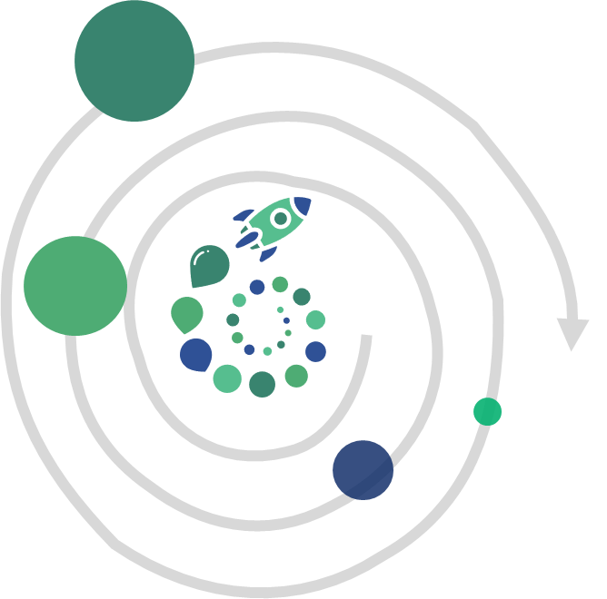


ACCESS TO ASSETS
Check out our contribution guidelines for information on how to get involved.
WWW.CONTINUOUS.ARCHITECTURE.ORG
We aim to make contributing to Continuous Architecture Toolkit a pleasant and enriching experience for all participants, and we welcome contributions of all kinds. Anyone can contribute to the project, regardless of their skills.

Slide 5

Continuous architecture toolkit was initially developed by Thierry Fraudet & Olivier Jauze from Michelin and by Nicolas Chevalier from Gluendo to setup an agile architecture operating model and to support the Michelin digital journey.
They were quickly joined by a small group of enthusiasts from DXC, Société Générale and others sharing the same ideas about the evolution of architecture in the world of information system design and this project is now maintains by the following core group of people.
Maintainers
Thierry Fraudet (MICHELIN)
Olivier Jauze (MICHELIN)
Nicolas Chevalier (GLUENDO)
Jean-marc Bunouf (SOCIETE GENERALE)
Jérémie Reignier (SOCIETE GENERALE)
Jérémie Grodziski (ADIXE)
Fréderic Le (DXC)
Antoine Lonjon (MEGA)
A group of maintainers to define the governance rules, ensure coherence within the different assets and validate the Toolkit content and enhancement.

